Slide 1
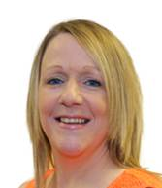
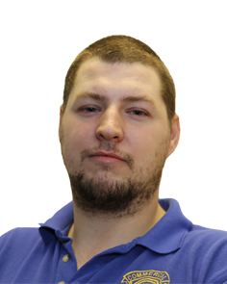
Organisation Chart
Clare
Dulson
Jason
Garratt
Marc
Waters
BUSINESS
VOCATIONAL
Tracy
Alcock
Emily
Booker

